Slide 1
Central Tendency
Descriptive Statistics

Slide 2
Overview
Central Tendency
Mean
Weighted Mean
Median
Mode

Slide 3
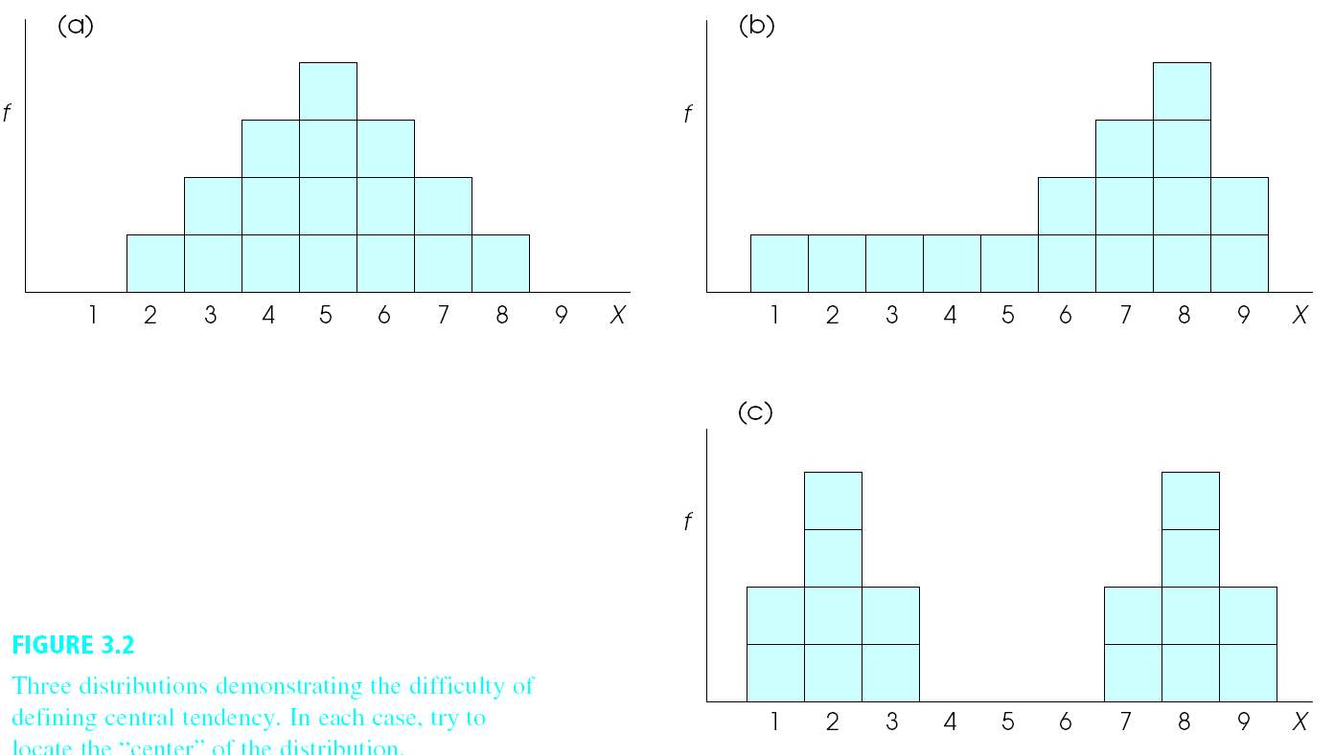
What Is Central Tendency?
Score that best captures the entire group of scores
Mean
Median
Mode
Notes:
Central tendency refers to the score that best captures, summarizes, or represents the entire groups of scores.
Essentially, it summarizes the location of a distribution (i.e., indicates where the center of the distribution tends to be located).
Simply creating a visual representation of the distribution often reveals its central tendency.
The central tendency is usually at (or near) the highest point in the histogram or the polygon. However, there are exceptions to this ‘high point of the distribution’ rule.
The first example (figure a) – it is pretty easy to say that the score that best represents the group is 5. The data seems to be centered around this value. It is about half between the two end points of the distribution. It is also the most frequently occurring number in the distribution.
However, for non-symmetrical distributions or distributions with more than one center of scores, it’s a little more difficult to define the center of the distribution. For the second example (figure b), is it 8? This is the most frequent score. Or would it be less than 8? Because 8 is not the middle of the scale.
Thus, there are three measures of central tendency:
Mode – is the number or event that occurs most frequently in a distribution.
Median – is the number or score that divides the distribution into equal halves (i.e., the median is the 50th percentile). To be able to calculate the median, you must first rank order the scores.
Mean – the mean is defined as the arithmetic average.
Figure from Gravetter & Wallnau page 61

Slide 4
Mean
Arithmetic average
Add scores & divide by # of scores
More Terms
Population mean μ (“mu”)
Sample mean M or X
Population N
Sample n
When writing in APA style N total sample, n for portion of sample
Notes:
The mean is the ‘typical’ score in a distribution - the balancing point in the distribution. To find the mean, you add up all the scores in the distribution and then divide by the number of scores that are added.
Just some reminders on terms
Numbers based on samples are called statistics.
Numbers based on populations are called parameters.

Slide 5
Mean: an exercise
Here is a data set: 2 3 3 5 6 7 9
What is the mean?

Slide 6
Answer
Here is a data set: 2 3 3 5 6 7 9
What is the mean?
2 + 3 + 3 + 5 + 6 + 7 + 9 35
------------------------------- = ------ = 5
7 7

Slide 7
Weighted Mean
Overall mean of 2 or more separate groups
Weighted
Sample 1: M = 5, n = 4
Sample 2: M = 3, n = 6
Σx₁=
Σx₂ =
Notes:
Sometimes it is useful to calculate the overall mean of two or more separate groups. The weighted mean is calculated when the two groups have different sample sizes.
The weighted mean is “NOT the halfway between the original two sample means. Because the samples are not the same size, one will make a larger contribution to the total group and therefore will carry more weight in determining the overall mean.”
So, imagine that we have one sample of 4 individuals who had a mean score of 5 and another sample of 3 individuals who had a mean score of 6.
We will need the overall sum of scores for group 1 and group 2 – that is, what is the sum of X for sample 1 and the sum of X for sample 2.
Because we already have M and n, we can use the mean formula to determine the sum of X.

Slide 8
Weighted Mean: Answers
Overall mean of 2 or more separate groups
Weighted
Sample 1: M = 5, n = 4
Sample 2: M = 3, n = 6
Σx₁= 5 x 4 = 20
Σx₂ =3 x 6 = 18
Notes:
Once, we find the sum of X for both samples, then we can use the weighted mean formula.

Slide 9
Weighted Mean Example
Hypothetical evaluations:
Instructor effectiveness 1-5 (high scores more effective)
Intro to Bio M = 3.25, n = 11
Intro to Bio M = 4.12, n = 25
What would the weighted mean be?
Notes:
Imagine that we have some hypothetical teaching evaluations of two different classes. One class had 11 students and the other class had 25 students. Because our sample sizes are unequal, we should calculate the weighted mean.

Slide 10
Weighted Mean Example
Hypothetical evaluations:
Instructor effectiveness 1-5 (high scores more effective)
Intro to Bio M = 3.25, n = 11
Intro to Bio M = 4.12, n = 25
What would the weighted mean be?
[(3.25 x 11) + (4.12 x 25)]/(11 + 25)
(35.75 + 103)/36
138.75/36
3.85

Slide 11
Median
Score at the 50th percentile (Mdn)
List scores in order from low to high
When n is odd
Median is middle number
When n is even
Median is halfway between middle 2 numbers
Ex: 2, 2, 4, 5, 6
Mdn = 4
Ex: 2, 2, 3, 3, 5, 5, 6, 8
Middle scores: 3 & 5
Halfway: (3 + 5)/2
Mdn = 4
Notes:
Median is the score that divides the distribution exactly in half (exactly 50% of the individuals score at or below the median).
We can determine this by
Arrange scores in order from lowest to highest
Determine the position of the midmost score

Slide 12
Mode
Most frequently occurring score
Any scale of measurement
Used for nominal scales
Problems:
Could be many modes
Does not take into consideration all of the data
Notes:
The most frequently occurring score is called the mode
The mode can be used to determine the most frequent value for any scale of measurement.
Typically used to describe central tendency when the scores reflect a nominal scale of measurement
Problems:
Could be many modes
Does not take into consideration all of the data

Slide 13
Mode
What is the mode of these data:
2 3 5 5 6 7 9
What is the mode of these data:
2 3 5 5 5 6 7 7 7 9
Notes:
The most frequently occurring score
Problem: May not be one unique mode

Slide 14
Mode
What is the mode of these data:
2 3 5 5 6 7 9
What is the mode of these data:
2 3 5 5 5 6 7 7 7 9
5
5 and 7 (these data are bimodal)
Notes:
The most frequently occurring score
Problem: May not be one unique mode

Slide 15
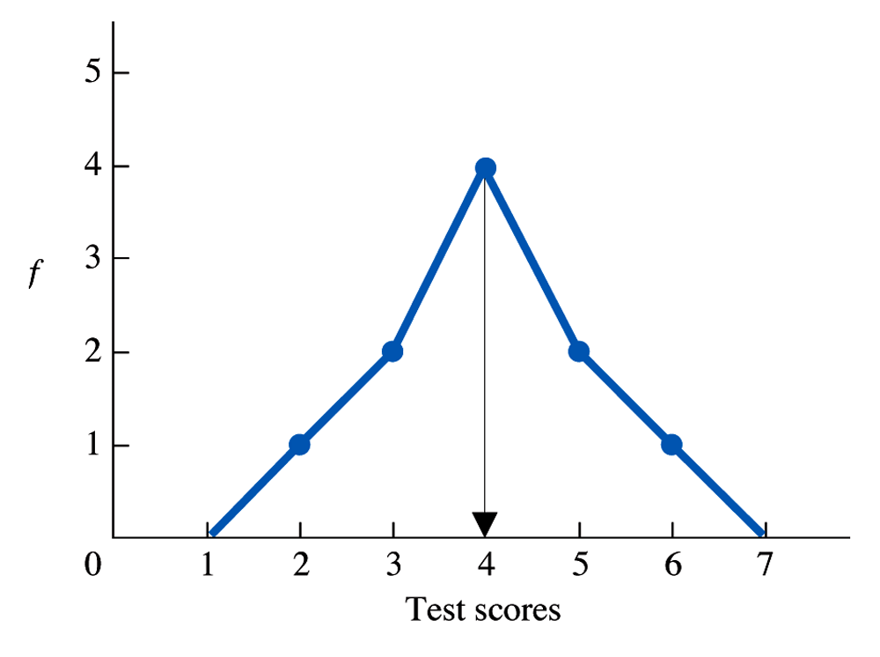
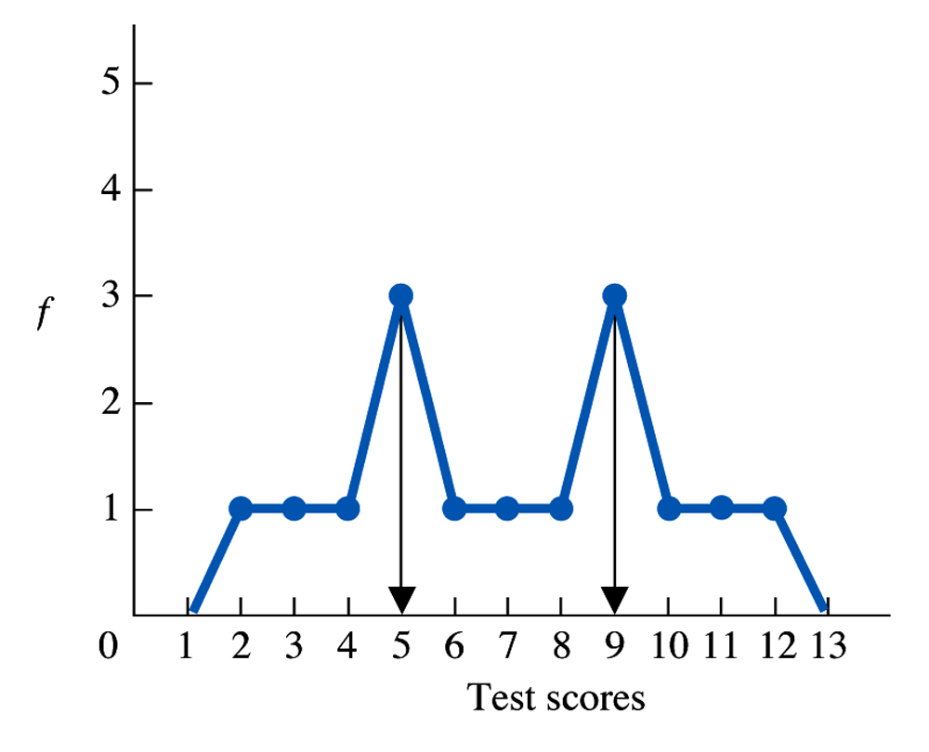
Distributions
Unimodal
Bimodal
Notes:
When a polygon has one hump (such as on the normal curve) the distribution is called unimodal.
When a distribution has two scores that are tied for the most frequently occurring score, it is called bimodal.

Slide 16
Measures of Central Tendency
Notes:
Although all three of these distributions are symmetrical, it is possible for the mode to fall in different locations.
Figure from Gravetter & Wallnau, page 81

Slide 17
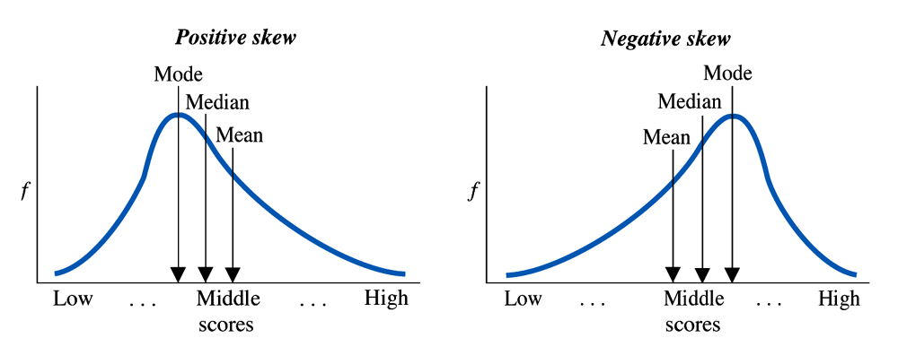
Measures of Central Tendency
Symmetrical (normal curve): M = Mdn = Mode
Positively skewed: M > Mdn ≥ Mode
Negatively skewed: M < Mdn ≤ Mode
Notes:
When the distribution is a symmetrical normal curve, the mean, median, and mode will look very similar.
When the distribution is positively skewed, the mode will be lower than the median and mean.
When the distribution is negatively skewed, the mode will be higher than the median and mean.

Slide 18
Which measure to use?
Score | f
5 | 1
4 | 2
3 | 4
2 | 2
1 | 1
f*score
f
1
2
3
4
5
What is n?
What is Σx?
What is M?
What is Mdn?
What is Mode?
Notes:
The idea that the mean is not always a central, representative value can be demonstrated by starting with a simple, symmetrical distribution consisting of scores 1, 2, 3, 4, and 5 with frequencies of 1, 2, 4, 2, and 1, respectively.
Just looking at the frequency distribution histogram, it is easy to see that the mean is 3, but you can also demonstrate that the n = 10 scores add up to ΣX = 30.
Mdn = 50% (finding the value at the 50% percentiles) (find percentiles based on cumulative percentages) (would also be (N+1)x.50 --- so the value 5.5 from the beginning of the distribution)
Mode = most frequent score
Just report mean in this situation (rather than mode and media) - The mean is used to summarize interval or ratio data in situations when the distribution is symmetrical and unimodal

Slide 19
Answers: Which measure to use?
Score | f
5 | 1
4 | 2
3 | 4
2 | 2
1 | 1
f*score
5
8
12
4
1
f
1
2
3
4
5
What is n?
What is Σx?
What is M?
What is Mdn?
What is Mode?
(1+2+4+2+1) = 10
Sum of f*score = 30
30/10 = 3
3
3
Mean usually used for interval or ratio data when distribution is symmetrical & unimodal.
1, 2, 2, 3, 3, 3, 3, 4, 4, 5
Notes:
The idea that the mean is not always a central, representative value can be demonstrated by starting with a simple, symmetrical distribution consisting of scores 1, 2, 3, 4, and 5 with frequencies of 1, 2, 4, 2, and 1, respectively.
Just looking at the frequency distribution histogram, it is easy to see that the mean is 3, but you can also demonstrate that the n = 10 scores add up to ΣX = 30.
Mdn = 50% (finding the value at the 50% percentiles) (find percentiles based on cumulative percentages) (would also be (N+1)x.50 --- so the value 5.5 from the beginning of the distribution)
Mode = most frequent score
Just report mean in this situation (rather than mode and media) - The mean is used to summarize interval or ratio data in situations when the distribution is symmetrical and unimodal

Slide 20
Which measure to use?
Score | f
55 | 1
4 | 2
3 | 4
2 | 2
1 | 1
f*score
55
8
12
4
1
f
1
2
3
4
55
What is n?
What is Σx?
What is M?
What is Mdn?
What is Mode?
Notes:
Now, change the score at X = 5 to X = 55.
What happens to the mean, median, and mode in this situation?

Slide 21
Which measure to use?
Score | f
55 | 1
4 | 2
3 | 4
2 | 2
1 | 1
f*score
55
8
12
4
1
f
1
2
3
4
55
What is n?
What is Σx?
What is M?
What is Mdn?
What is Mode?
(1+2+4+2+1) = 10
Sum of f*score = 80
80/10 = 8
3
3
Median is preferred if there are a few extreme scores or the distribution is very skewed.
Notes:
The new mean (adding 50 points to one score adds 50 points to the total, so ΣX is now 80 and the mean is 8).
Note that the new mean, 8, is not a representative value. In fact, none of the scores are located around X = 8.
Finally, you can introduce the median using the original distribution (median = 3) and then see what happens to this measure of central tendency when X = 5 is moved to X = 55 (the median is still 3). Thus, the median is relatively unaffected by extreme scores.
When there are extreme scores or your data is extremely skewed, the median is a better representation of the scores.

Slide 22
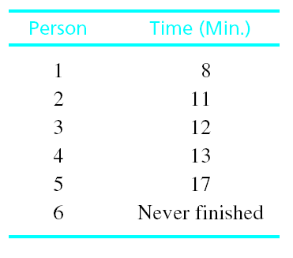
Which measure to use?
Also use median if:
There are undetermined or unknown values
Open ended distributions
1, 2, 3, 4 or more
Ordinal data
Notes:
Also use the median if:
There are undetermined or unknown values
Example from Gravetter & Wallnau: Time to complete a puzzle. After 60 minutes, someone still hasn’t completed the puzzle. Could tell us that there is a segment of the population that can’t complete the puzzle (so shouldn’t necessarily throw out the data). Not really correct to give them 60 minutes (because they didn’t actually solve the puzzle in that time period).
We have no value for them, can’t compute a mean – but we could determine the median.
Open ended distributions – lacks an upper or a lower limit for a category
E.g., yrs in school (1, 2, 3, 4, or more). Can’t compute a mean because we don’t know the exact values for those in the 4 or more category. But we can compute the median.
Ordinal scales – mean is not appropriate for ordinal data, median is preferred.
Why? Recall ordinal scales allow us to tell the direction (e.g., who was first, second, etc.), but says nothing about the distance between the scale points. Mean measures distance, so it’s inappropriate for this type of data.

Slide 23
Which measure to use?
Mode is most appropriate for:
Nominal scales
Discrete variables
As an add on, gives a sense of distribution shape
Notes:
Mode is most appropriate for:
Nominal scales
Discrete variables
As an add on, gives a sense of distribution shape

Slide 24
Example
Construct a frequency table and a graph.
Add columns for relative frequencies, cumulative frequencies, & cumulative percents.
Determine ΣX, n, M, Mdn, Mode.
Determine the shape of the distribution.
If you could only report one measure of central tendency then which would you choose and why. (interval data)
14 | 14 | 13 | 15 | 10 | 9 | 15
13 | 10 | 12 | 13 | 14 | 13 | 12
8 | 15 | 17 | 14 | 9 | 15 | 16
Notes:
Suggest that you try doing this on your own first (that way you can figure out what you really know) – not going to have any help on the exam.
When you get stuck, do bug your neighbor. I’ve noticed most people in here are very helpful. And having you help someone else will help solidify the information in your own head. If you are able to explain it to someone else, then it really shows that you know the material.
Once you think you have everything, check with a neighbor.
Then finally, I have the answers in the front that I’ll just leave up here. I don’t want people to feel extremely rushed, but at the same time I don’t want those of you who are quickly getting it to sit around twiddling your thumbs.
If people finish early – work on observational projects, research proposals.

Slide 25
Answers
Scores | f | f*scores | rf | cf | C%
17 | 1 | 17 | .05 | 21 | 100%
16 | 1 | 16 | .05 | 20 | 95%
15 | 4 | 60 | .19 | 19 | 90%
14 | 4 | 56 | .19 | 15 | 71%
13 | 4 | 52 | .19 | 11 | 52%
12 | 2 | 24 | .10 | 7 | 33%
11 | 0 | 0 | .00 | 5 | 24%
10 | 2 | 20 | .10 | 5 | 24%
9 | 2 | 18 | .10 | 3 | 14%
8 | 1 | 8 | .05 | 1 | 5%
Notes:
N = 21

Slide 26
Frequency of Scores
f
8
9
10
11
12
13
14
15
16
17
Scores

Slide 27
Answers
n = 21
ΣX = 271
M = 12.90
Mdn = 13
Mo = 13, 14, 15
There are three modes and there is a slight negative skew. It is not quite a normal distribution, but because the mean, median, and mode are very similar it suggests the skew is not dramatic.
I would report mean, because the distribution is not skewed dramatically.

